Slide 1

CAMFAS: A Compiler Approach to Mitigate Fault Attacks via Enhanced SIMDization
Zhi Chen¹, Junjie Shen¹, Alex Nicolau¹, Alex Veidenbaum¹
Nahid Farhady Ghalaty² and Rosario Cammarota³
¹University of California, Irvine
²Accenture Cyber Security Technology Labs, Virginia, USA
³Qualcomm Research, San Diego, USA

Slide 2
Fault Attacks
Fault attacks occur as intentional disturbance of a micro-processor
  To exploit the secret keys of crypto modules.
  To take control of the micro-processor actions.

Slide 3
Fault Attack Process
Fault attack vectors include two main steps:
  Fault measurement – the process to get faulty data
    Fault Injection.
    Fault effect observation.
  Fault analysis – techniques to process faulty and unaltered information
    E.g., DFA, DFIA.

Slide 4
Fault Attack Countermeasures
Fault attack countermeasures attempt to prevent an attacker from observing the effect of injected faults.
  Shielding to physically block fault injection
  Sensors to detect fault injections
    E.g., temperature, EM, voltage anomaly sensors.
  Redundancy for fault detection
    E.g., error-correcting codes (hardware), multi-versioning (software).

Slide 5
Motivation
Type | Overhead | Cost | Flexibility | Efficacy
Hardware | High | High | Low | High
Software | High | Moderate | High | Low
Table 1: Existing countermeasures on a yardstick.
Recent research has shown that multiple fault injections can break redundancy techniques in algorithm or instruction level - refer to Yuce et al. in FDTC’16
Hardware countermeasures
  Overhead impact silicon area and performance.
  Increase the hardware design life cycle.
  Limited flexibility.
Software countermeasures (timing and spatial code redundancy)
  Overhead impact memory footprint, code size, and register pressure, i.e., performance
    E.g., run crypto algorithm twice, duplicate instructions
  Tedious and error-prone deployment of the countermeasures.
  Highly flexible.

Slide 6
CAMFAS
Rationale
  Rely on the mechanism of automatic vectorization (SIMDization) to convert instruction duplication into vector operations.
  Vector units are ubiquitous in modern micro-processors
    Intel x86 – SSE, AVX
    ARM - NEON
Expected outcome
  Reduced performance penalty compared to instruction duplication.
  Elevated fault coverage due to a reliable insertion of the mitigation with an enhanced version of the auto-vectorizer of the compiler: CAMFAS.

Slide 7
CAMFAS Framework
ALU instructions: Duplicated and their data is placed in SIMD registers.
Memory instructions: Memory addresses are duplicated using gather and scatter.
Branches: Condition computation is duplicated. PC update is not checked.
Calls: Function calls are not duplicated, but some library calls are duplicated if they have the equivalent SIMD prototypes in LLVM IR (e.g. sqrt, pow, etc.).

Slide 8
ALU Instruction Duplication
Original
A
B
C
Replicate
B
B’
C
C’
Vector operation
A = B + C
A’ = B’ + C’
Shuffle
A’ = B’ + C’
A = B + C
Compare
+1/0/-1
+1/0/-1
There is an error if one of the fields is non-zero

Slide 9
Memory Instruction Duplication
Only addresses are protected.
  Load instruction: gather.
  Store instruction: address is checked before store.
Data can also be checked at the cost of more overhead
Original: D = Mem[A]
Memory
Gather
...
Addr: A
Addr: A’
D
D’

Slide 10
Error Checking Insertion
Shuffle + Compare.
Error checking code only inserted at selected positions to reduce the performance overhead.
  Before stores.
  Before function calls.
  Before conditional branches.
A
A’
A==A’
A’==A
A’
A

Slide 11
Fault Injection Simulation
Use Pin tool to collect dynamic instruction trace.
Randomly pick a fault position in trace file.
  Pick an instruction
  Flip the chosen bit
Repeat fault injection 1000 times for each crypto algorithm.
  → pick a register
  → pick a bit
Crypto
algorithm
1 | 0 | 0 | … | 1 | 0
1 | 0 | 0 | … | 0 | 0
Pin Tool
Rand(0, 31)
ip1, regs_i, regs_o
ip2, regs_i, regs_o
ip3, regs_i, regs_o
…
ipn, regs_i, regs_o
Rand(1, n)
ip1, regs_i, regs_o
ip2, regs_i, regs_o
ip3, regs_i, regs_o
…
ipn, regs_i, regs_o
Rand(regs_i)
1 | 0 | 0 | … | 1 | 0
Regs_i[1]
Trace File

Slide 12
Evaluation
Experimental Platform
CPU | Intel Xeon PhiTM 7210 with AVX-512 SIMD extension
Memory | 16GB
OS | Ubuntu Server 16.04 with Linux-4.4.0 kernel
Compiler framework | LLVM 4.0
Target | Libgcrypt-1.7.6
CAMFAS can also be applied to other micro-processors support vector extensions.
  e.g. ARM processors w/ NEON

Slide 13
Cipher Execution Results
Detected: program terminates due to fault being detected.
Incomplete: execution fails without generating attackable output.
Masked: program completes normally and produces correct output.
Corrupted: program completes normally and produces faulty output.
The fault provides useful information to an attacker for its fault analysis step

Slide 14
Fault Coverage
Almost full coverage
with memory protection!
The remaining corrupted cases are mainly caused by faults injected to error checking code
N: No fault detection
O: CAMFAS without memory protection
W: CAMFAS with memory protection

Slide 15
Performance overhead
With memory protection: 2.2x.
Without memory protection: 1.7x.

Slide 16
Discussion
Differential Fault Analysis (DFA)
  Requires both correct and faulty cipher texts.
  CAMFAS detects incorrect result and prevents the generation of faulty cipher text.
Differential Fault Intensity Analysis (DFIA)
  Relies on the bias of fault behavior.
  CAMFAS effectively prevents faulty output from being propagated.
Single-Glitch Attack
  Injects clock glitches at precisely controlled timing and pipeline stages to thwart redundancy-based countermeasures
  CAMFAS makes the attack more difficult as duplication and error checking are inserted at the IR level

Slide 17
Conclusions
CAMFAS is a redundancy-based countermeasure implemented in LLVM infrastructure.
CAMFAS exploits SIMD units in modern micro-processors to mitigate fault attacks.
CAMFAS provides high fault coverage while keeps a moderate performance penalty.
Future directions
Extend CAMFAS to thwart side-channel attacks.
New micro-architectural features to mitigate fault attacks.

Slide 18
Thank you!

Slide 19
Backup Slides

Slide 20
Fault injections can be detrimental
Methods: Laser, EM, heat, etc.
Common approach: Differential Fault Analysis (DFA)
A single fault is enough to break the cryptosystem
  Public key cipher: “Bellcore attack” on RSA-CRT [1]
  Block cipher: DFA on AES [2]
[1] Boneh, Dan, Richard A. DeMillo, and Richard J. Lipton. "On the importance of eliminating errors in cryptographic computations." Journal of cryptology 14, no. 2 (2001): 101-119.
[2] Tunstall, Michael, Debdeep Mukhopadhyay, and Subidh Ali. "Differential fault analysis of the advanced encryption standard using a single fault." IFIP International Workshop on Information Security Theory and Practices. Springer, Berlin, Heidelberg, 2011.

Slide 21
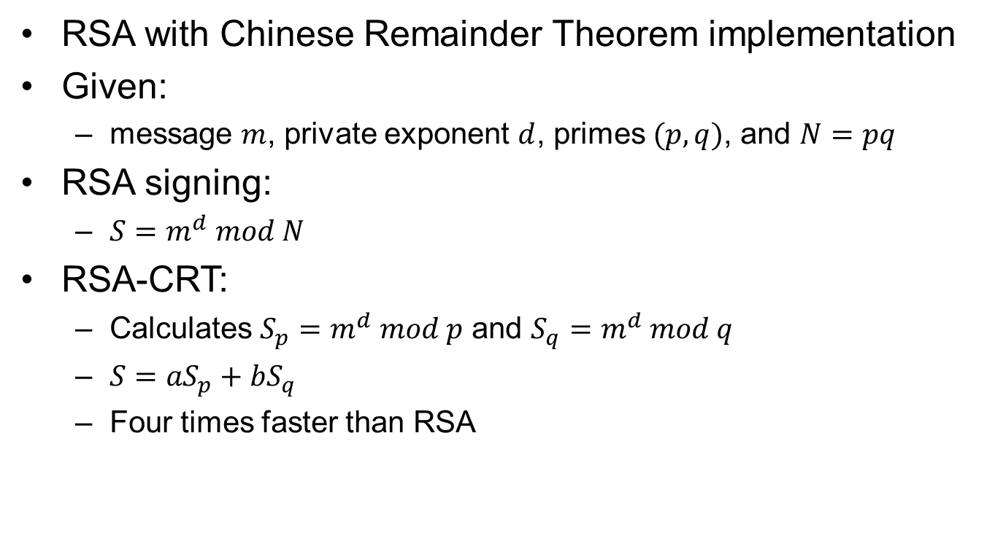
RSA-CRT
RSA with Chinese Remainder Theorem implementation
Given:
  message $m$, private exponent $d$, primes $(p,q)$, and $N=pq$
RSA signing:
  $S=m^{d} mod N$
RSA-CRT:
  Calculates $S_{p}=m^{d} mod p$ and $S_{q}=m^{d} mod q$
  $S={aS}_{p}+{bS}_{q}$
  Four times faster than RSA

Slide 22
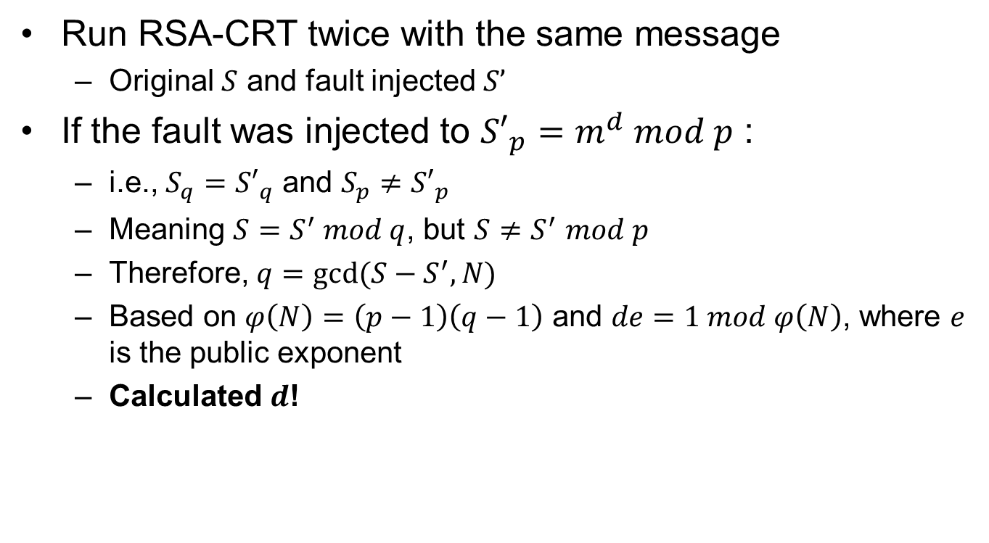
Bellcore Attack
Run RSA-CRT twice with the same message
  Original $S$ and fault injected $S’$
If the fault was injected to ${S′}_{p}=m^{d} mod p$ :
  i.e., $S_{q}={S′}_{q}$ and $S_{p}≠{S′}_{p}$
  Meaning $S=S^{′} mod q$, but $S{≠S}^{′}mod p$
  Therefore, $q=gcd⁡(S−S^{′}, N)$
  Based on $φ\left(N\right)=\left(p−1\right)\left(q−1\right)$ and $de=1 mod φ\left(N\right)$, where $e$ is the public exponent
  Calculated $d$!

